Slide 1

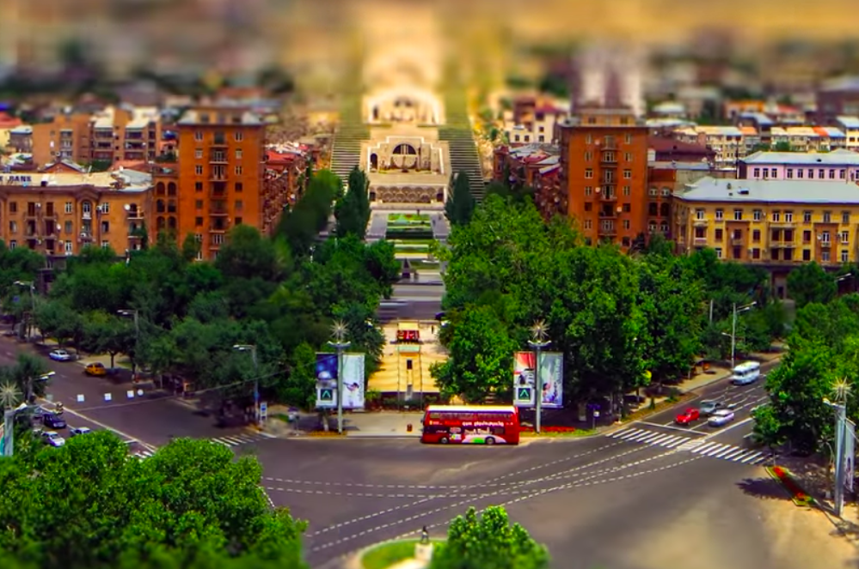

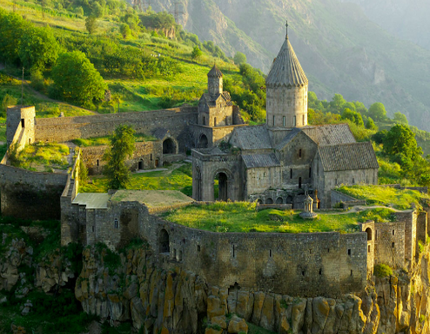
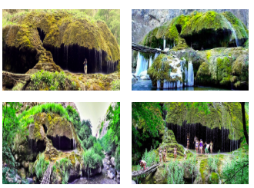
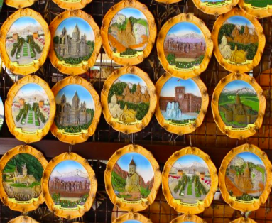
ArmeniaN Trip
Lecturer: A.Margaryan.
Students: M. Sofyan, V. Hakobyan, M. Grigoryan

Slide 2



ArmeniaN Trip
State Engineering University of Armenia (2010 - 2014)
State Engineering University of Armenia (2014 - 2016)
Armenian Code Academy (2019 - 2020)
M. Sofyan
National Polytechnic University of Armenia (2007 – 2011)
Armenian State Pedagogical University (2011 – 2013)
BeeOnCode (2019), Armenian Code Academy (2019 - 2020)
Portfolio
https://hakobyanviktoria8.github.io/my-new-portfolio/
V.Hakobyan
“Quantum“ college (2016- ...) (C++)
Tumo (2016-2019)
Microsoft techno camp Armenia (HTML, CSS, C#)
Armenian Code Academy (2019 - 2020)
M. Grigoryan

Slide 3
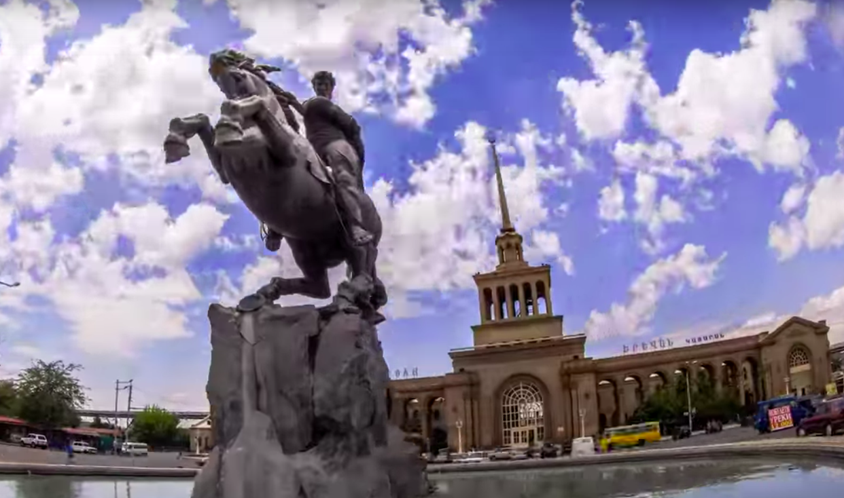
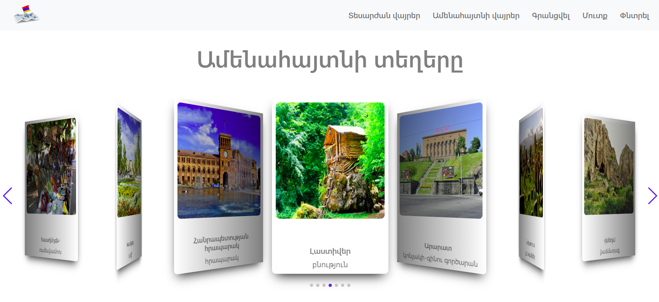
ArmeniaN Trip
HOME

Slide 4
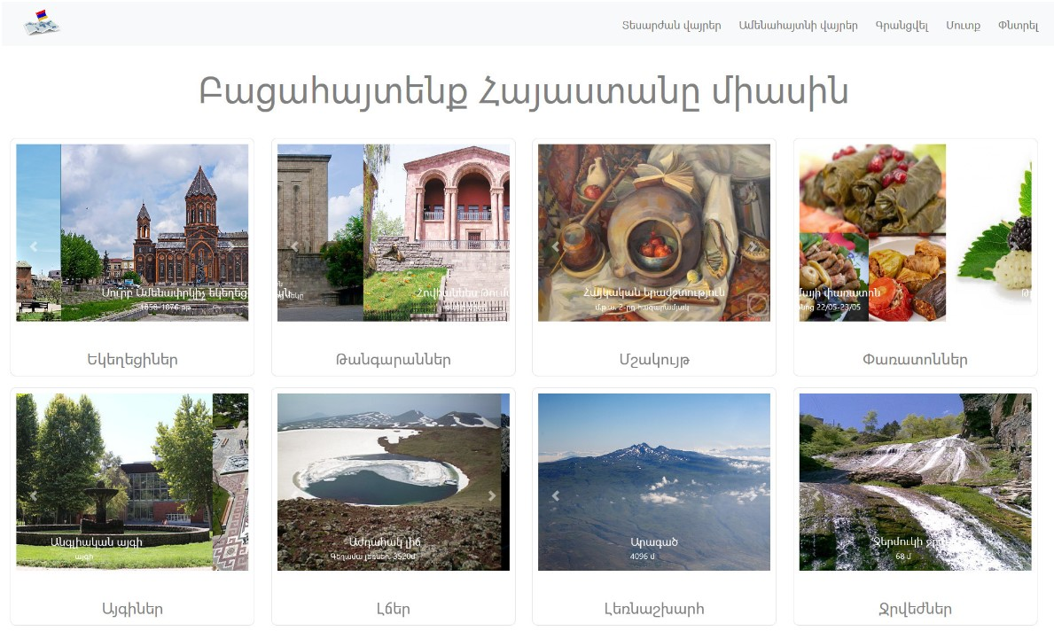
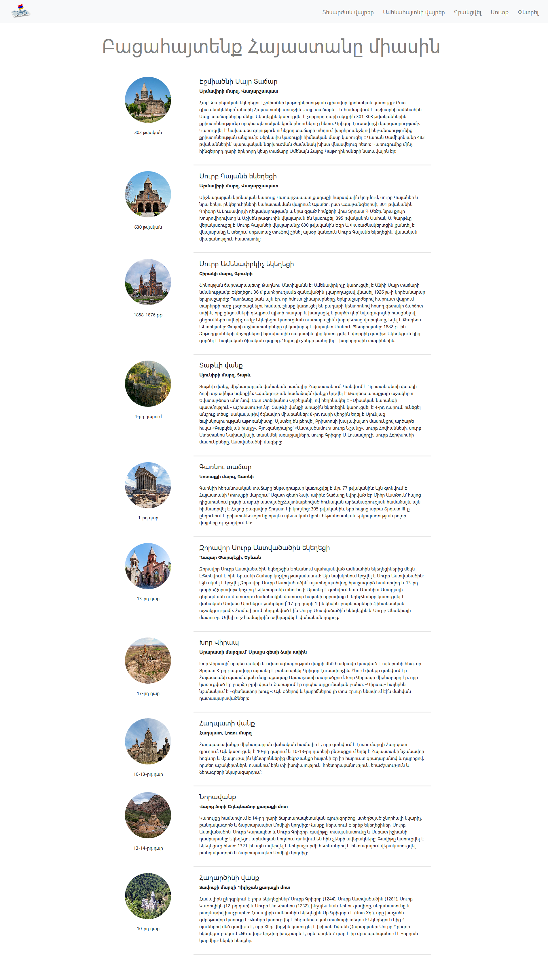
ArmeniaN Trip
SIGHTSEEING

Slide 5
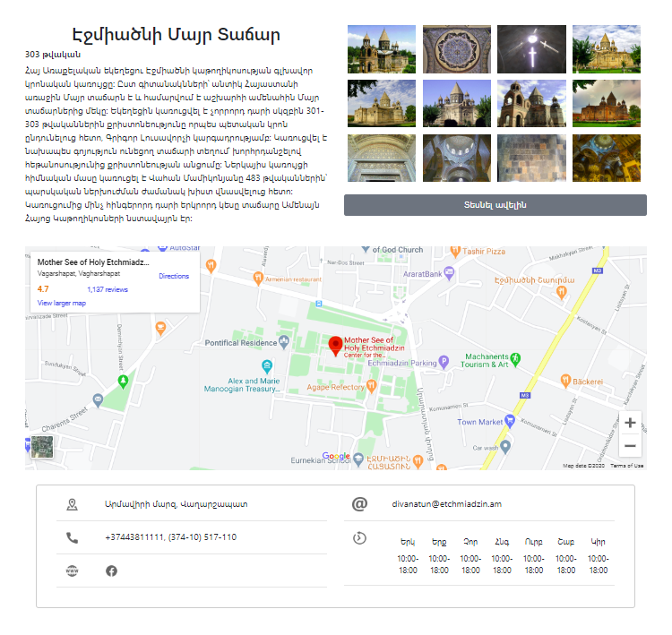
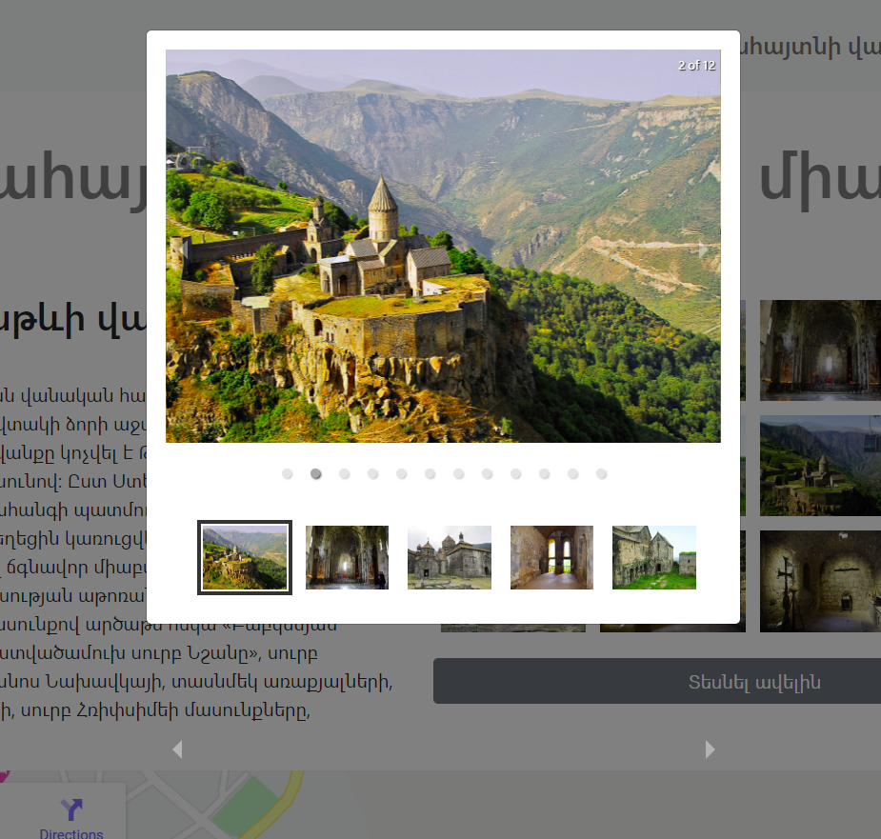
ArmeniaN Trip
SIGHTSEEING

Slide 6
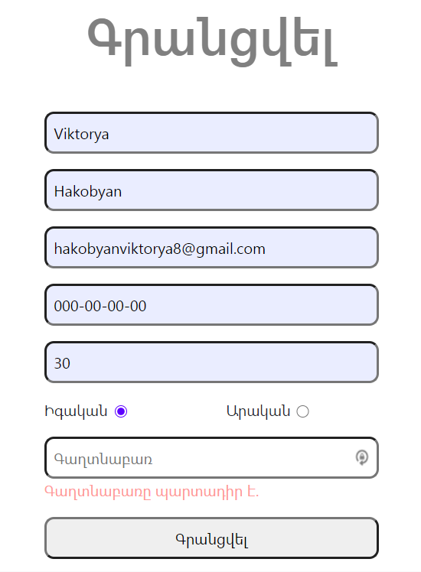

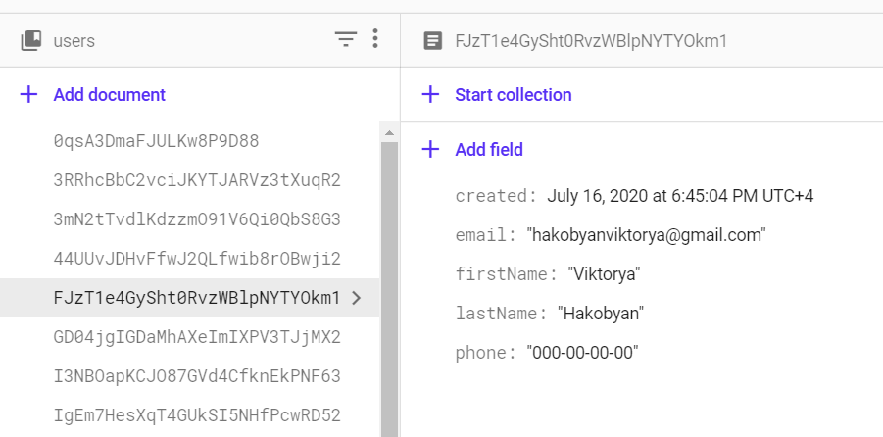
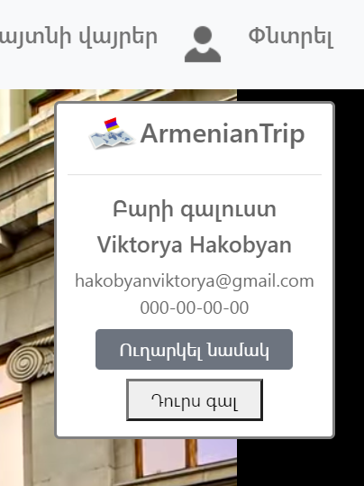
ArmeniaN Trip
REGISTRATION / LOGIN

Slide 7
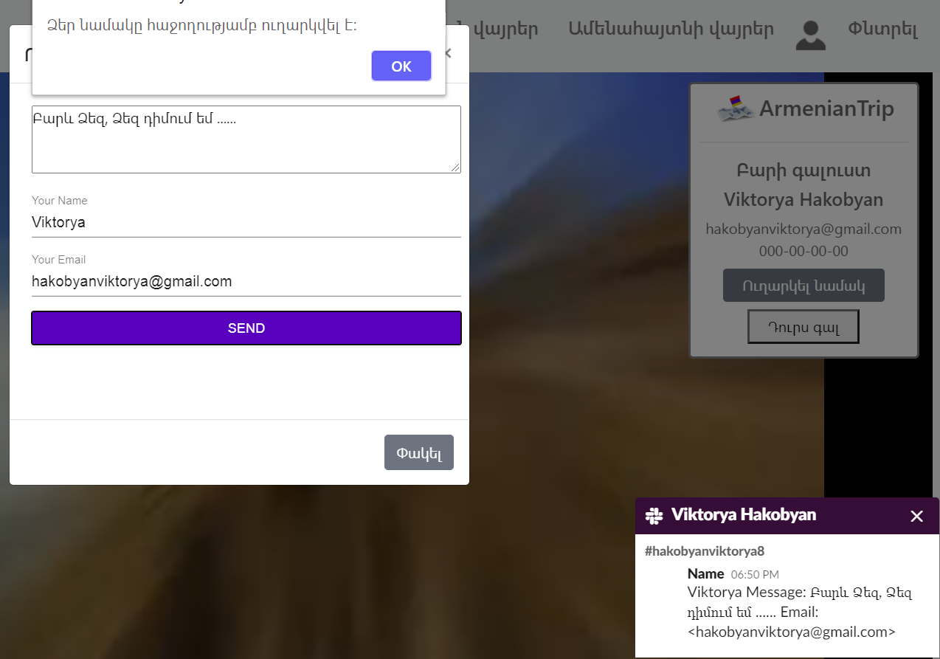
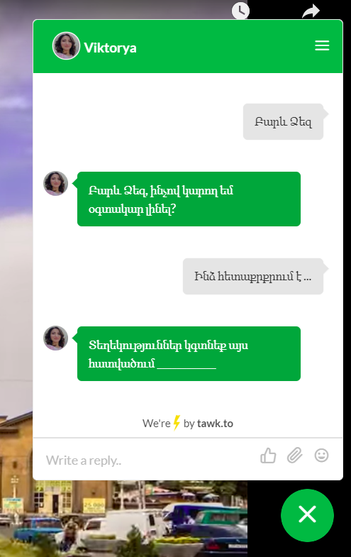
ArmeniaN Trip
REGISTRATION / LOGIN

Slide 8
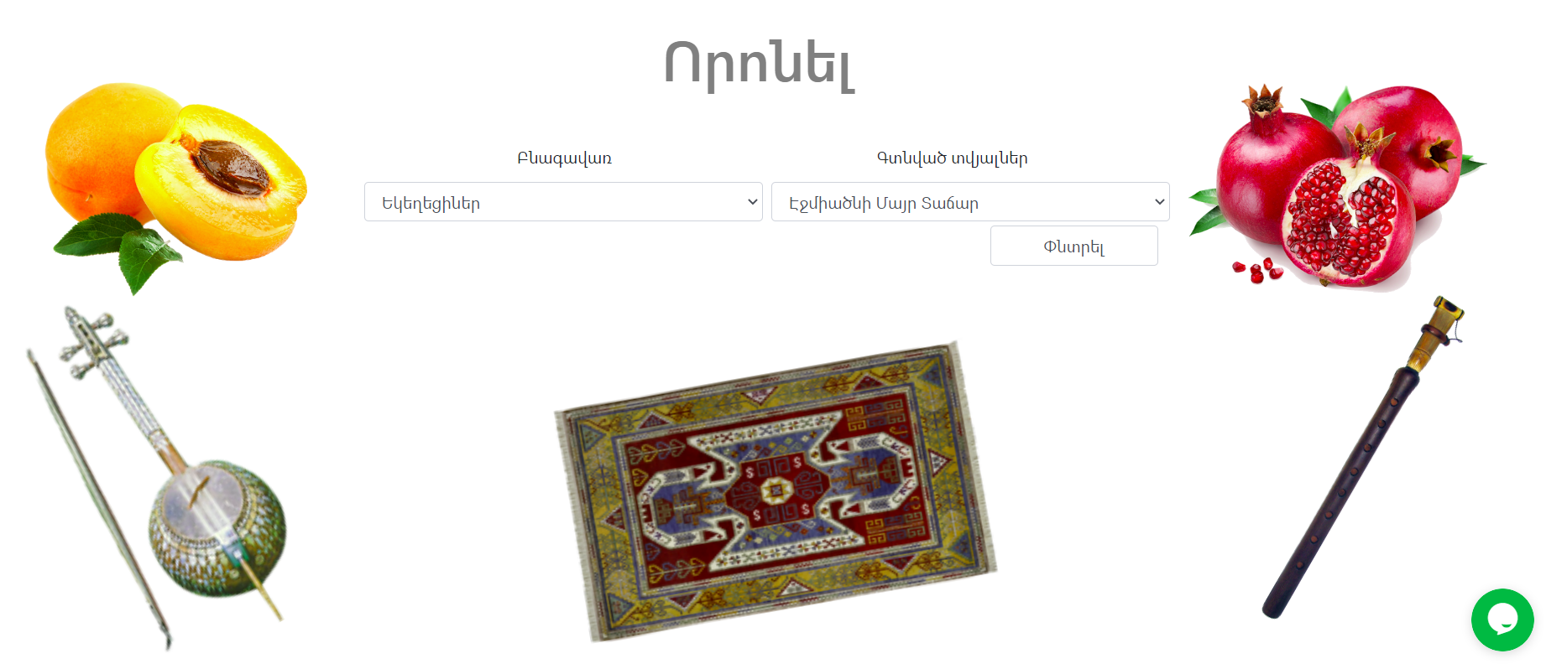
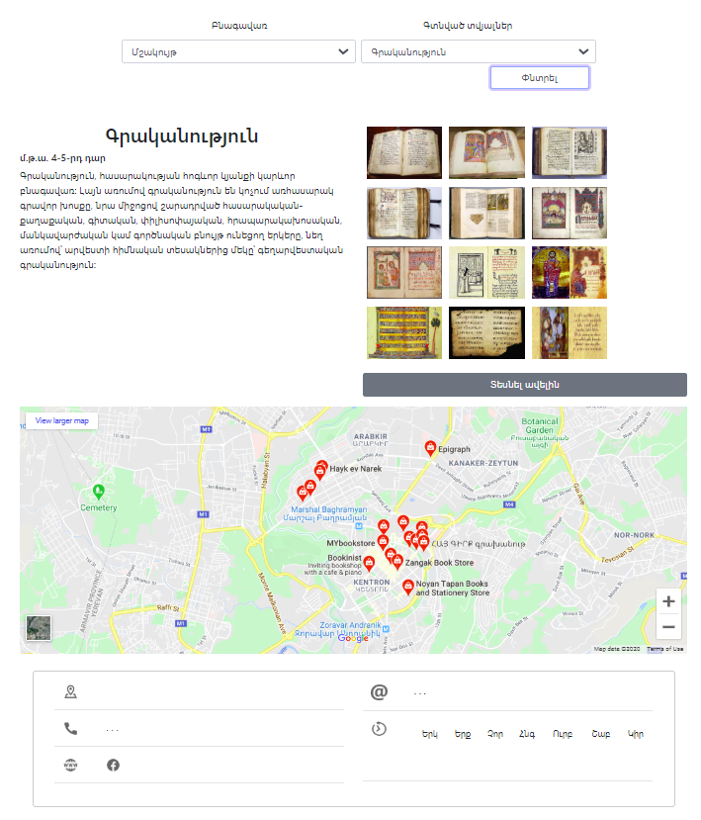
ArmeniaN Trip
SEARCH

Slide 9
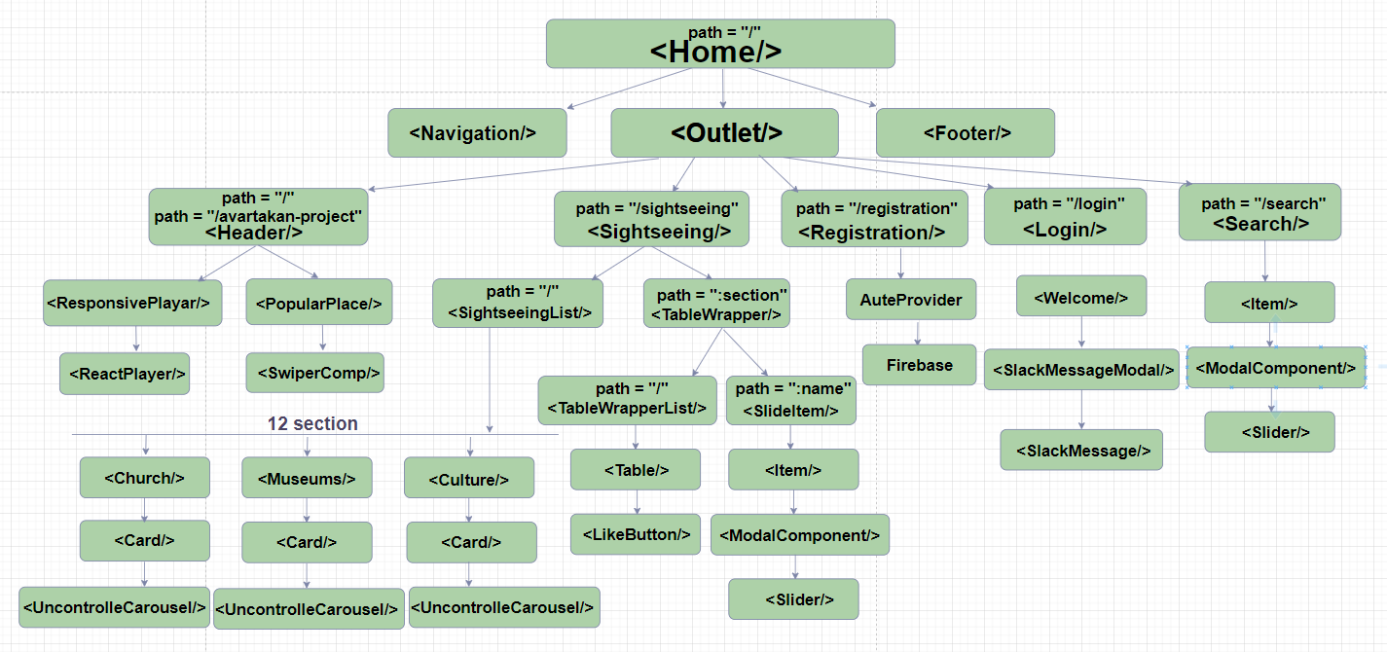
ArmeniaN Trip
ROUTER / COMPONENT

Slide 10
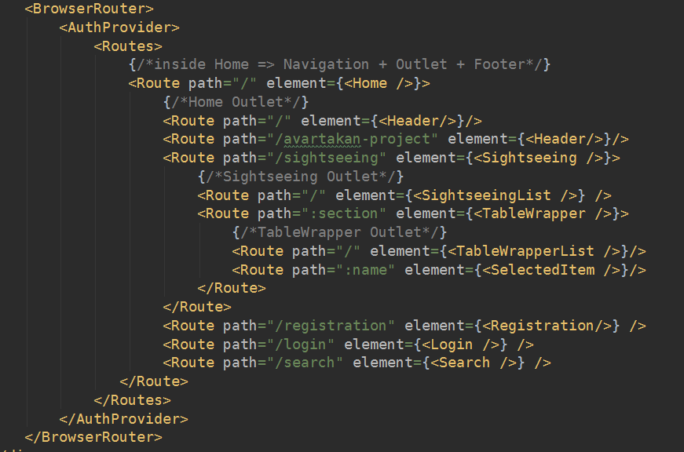
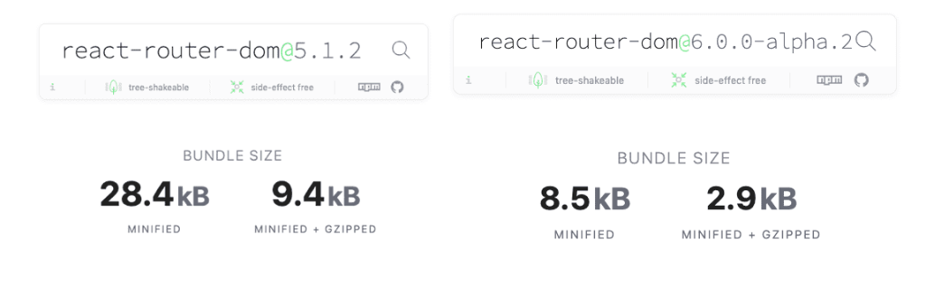
ArmeniaN Trip
ROUTER / COMPONENT
ROUTER 6.0.0
1.Total bundle size decreased 70%
2. <Routes> instead <Switch>
3. <Route path> and <Link to>
4. Exact default
5. Route and Link automatically --- build upon the path
6. Nested Routes code readability
---<Outlet>
7. Access to the history use hook --- useNavigate

Slide 11
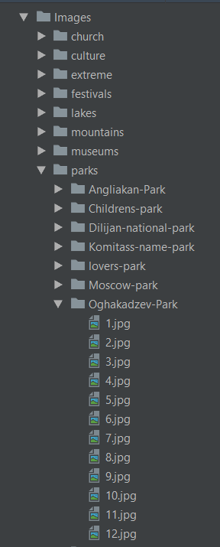
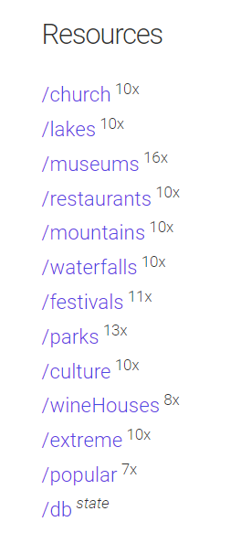
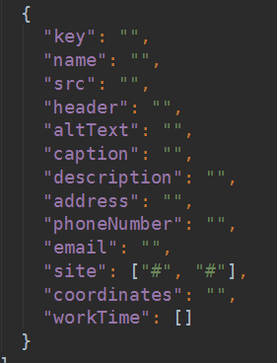
ArmeniaN Trip
CREATE OUR DATABASE
Create db.json
Git clone https://github.com/jesperorb/json-server-heroku.git
Creating a git repository on GitHub
Create a project on Heroku https://am-places.herokuapp.com/:section/:name
Commit our changes to git
Push our app to Heroku
Db.json file
12 array
120+ object
1500+ images

Slide 12
ArmeniaN Trip
USE LIBRARY / COMPONENT
1. Reactstrap: NavBar, UncontrolledCarousel, Modal, Container, Row, Col
2. Carusel, Swiper, React Player, React ID Swiper Components
3. Registration form validation: React Hook Form
4. React Router 6.0.0 HOOK: useParams, useNavigate
5. Function, Class Components
6. HOOK : useState, useEffect, useContext, useCallback
7. Fetch, Axios
8. Users Data: Firebase
9. Send message Slack
10. Send message Tawk.to
11. API: https://am-places.herokuapp.com
12. Git https://hakobyanviktoria8.github.io/avartakan-project/

Slide 13
ArmeniaN Trip
Thank you

